Slide 1
City Navigator
By:
Madhav - GIC1221021
Ravitej Kaur – GIC1221002
Sangavi - GIC1221003
Varshini - GIC1221001

Slide 2
Index
Introduction
Module
Software Interface
Hardware Interface
Use Case Diagram
Class Diagram
Sequence Diagram
Project Screenshots

Slide 3
Introduction
Describing a set of technology-based solutions.
Redefines the travelling experience.
Providing details of the places and restaurants for different states.
Provides details for travelling.

Slide 4
Module
Customer

Slide 5
Software Interface
Tool: Spring Tool Suite
Languages: HTML, CSS, Java
Database: MySQL

Slide 6
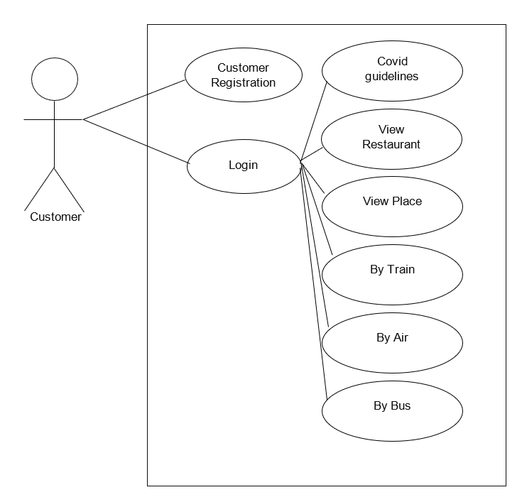
Use Case Diagram

Slide 7
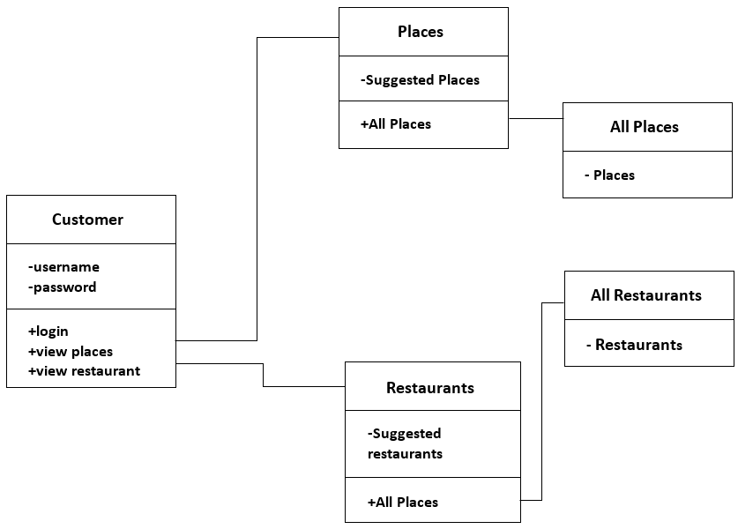
Class Diagram

Slide 8
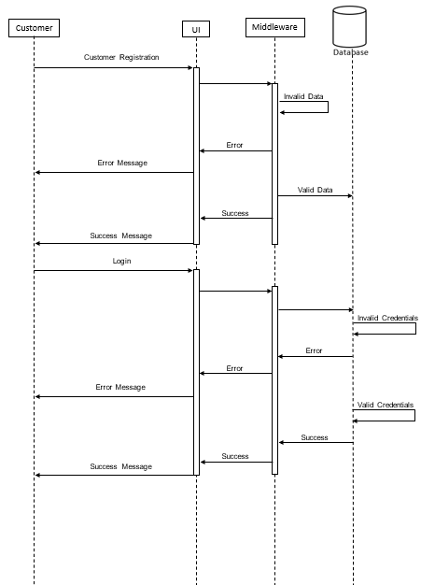
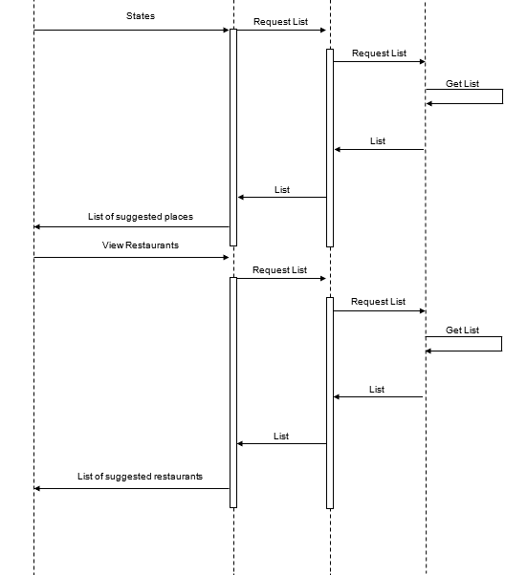
Sequence Diagram

Slide 9
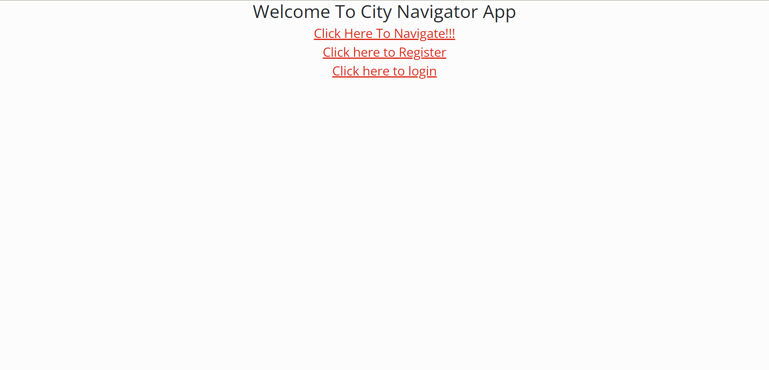
Project Screenshots - Home

Slide 10
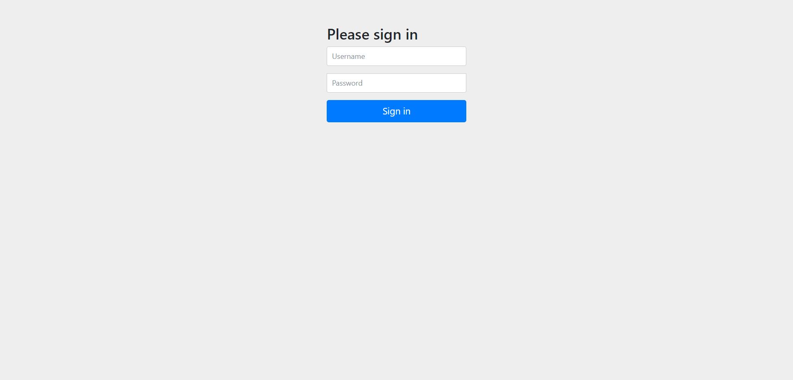
Project Screenshots – Login Page

Slide 11
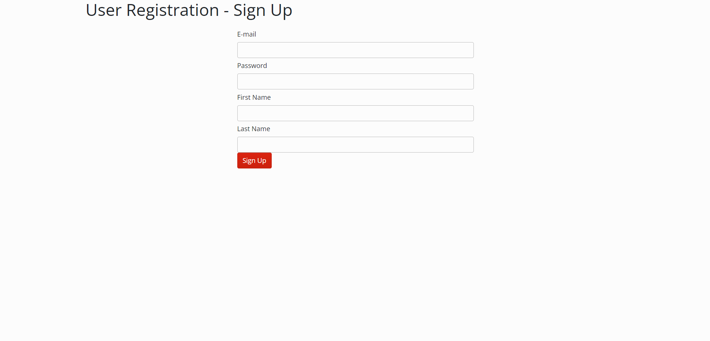
Project Screenshots – Registration Form

Slide 12
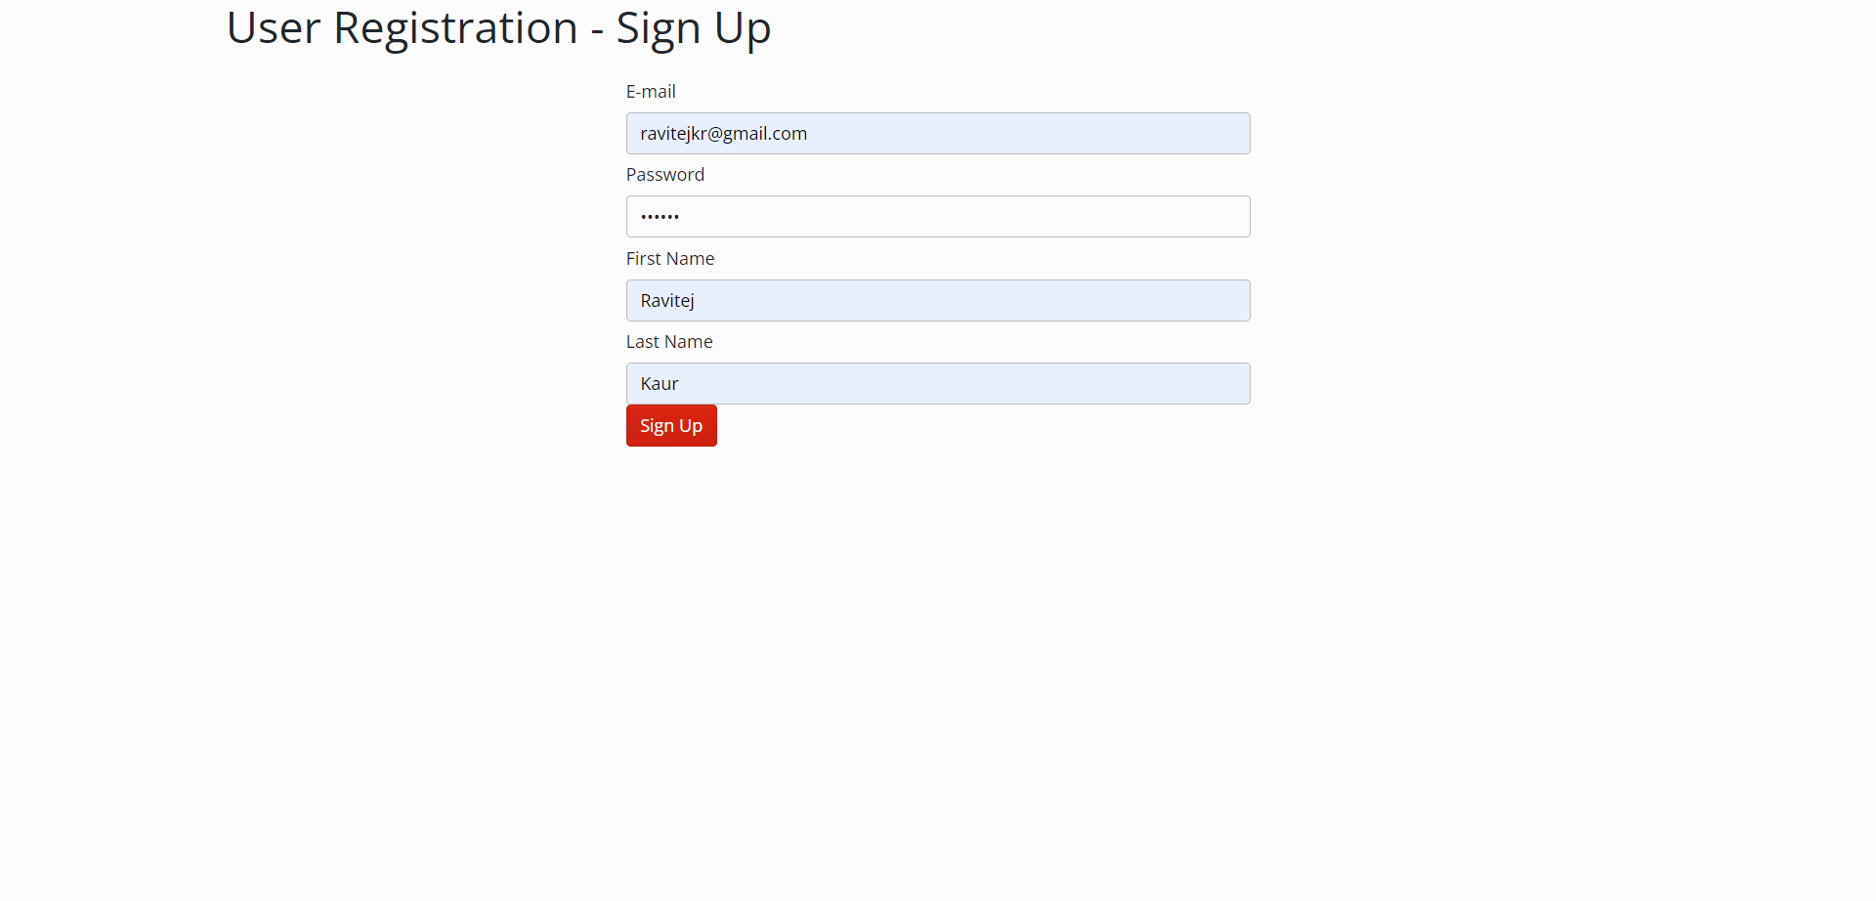
Project Screenshots – Registration Form

Slide 13
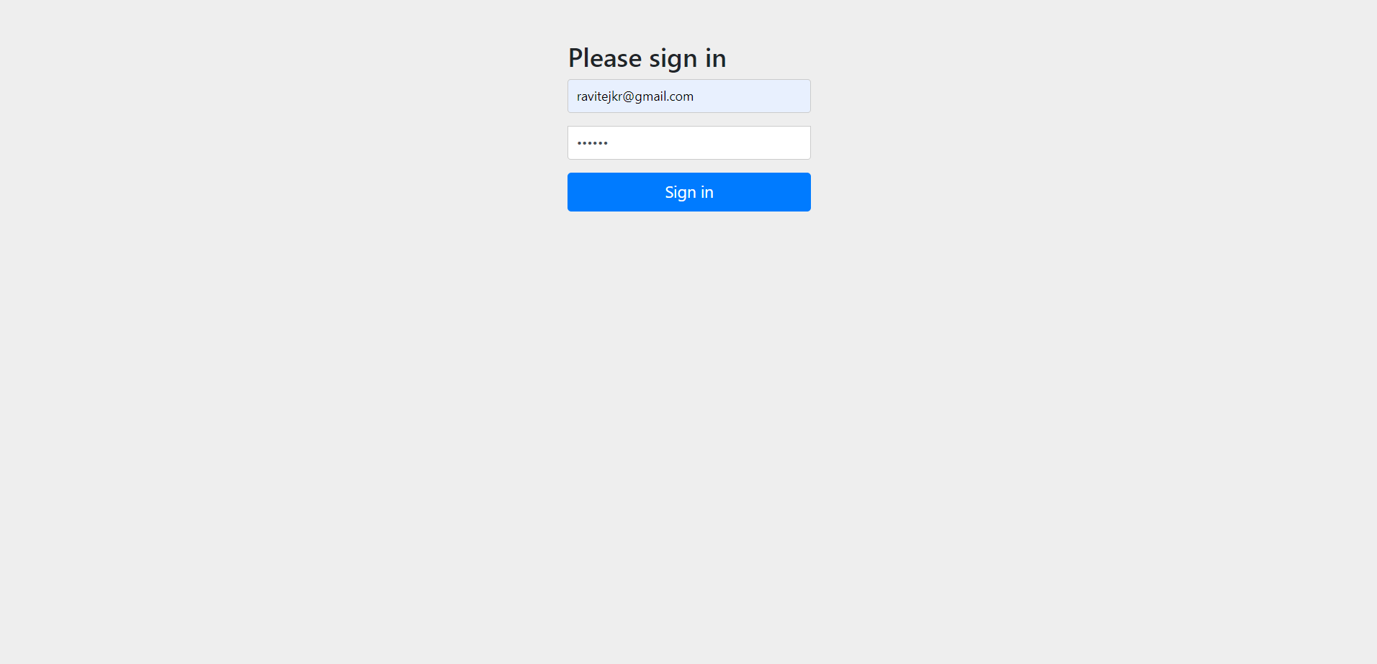
Project Screenshots - Logging

Slide 14
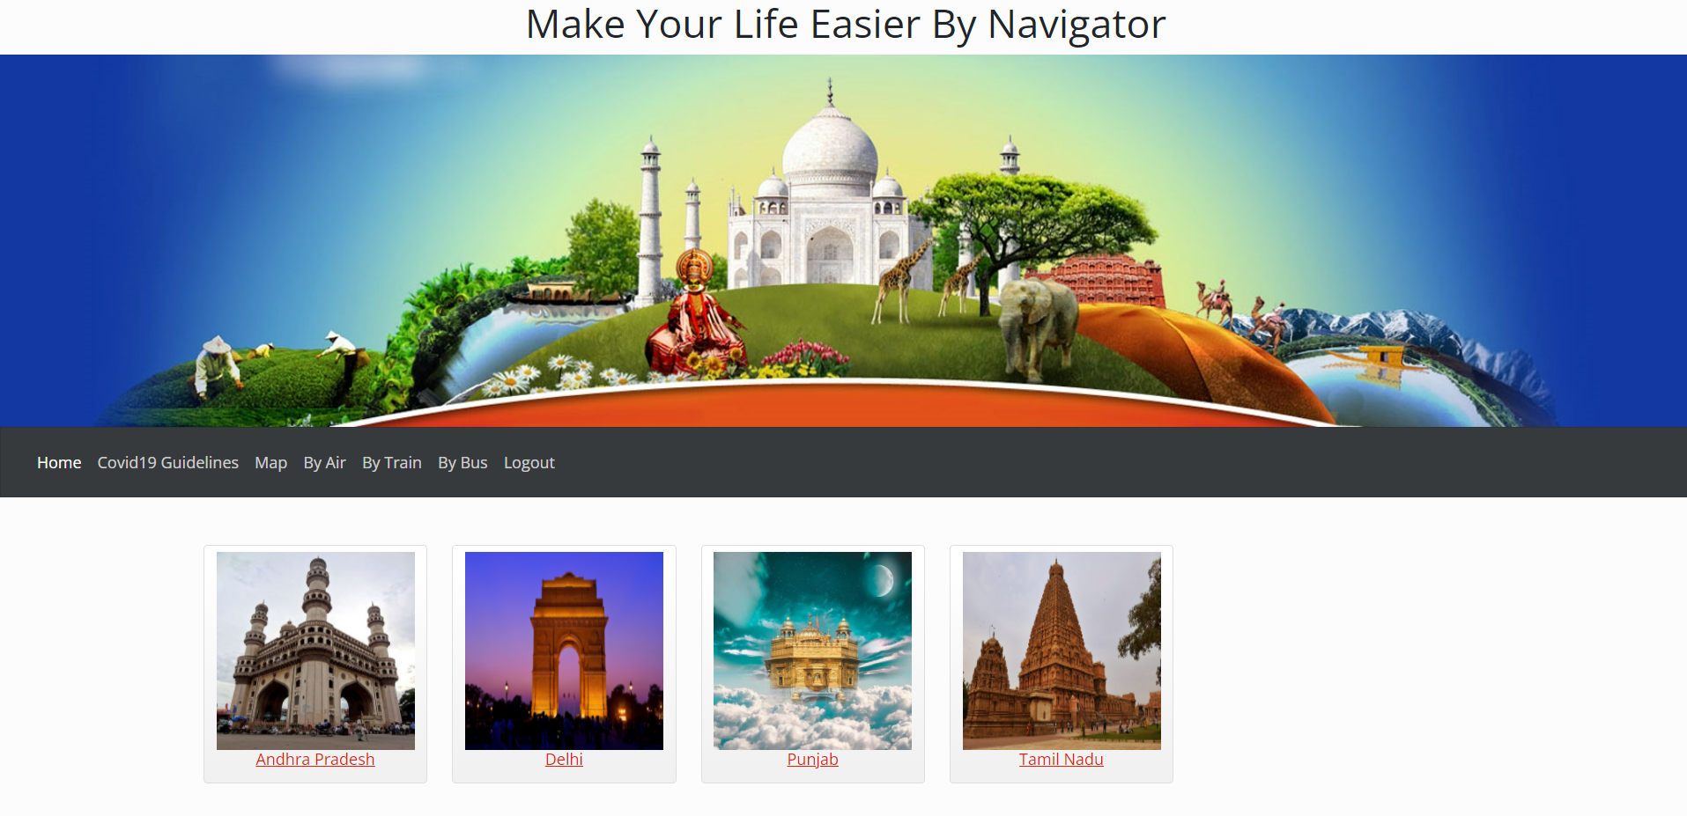
Project Screenshots – Customer Profile

Slide 15
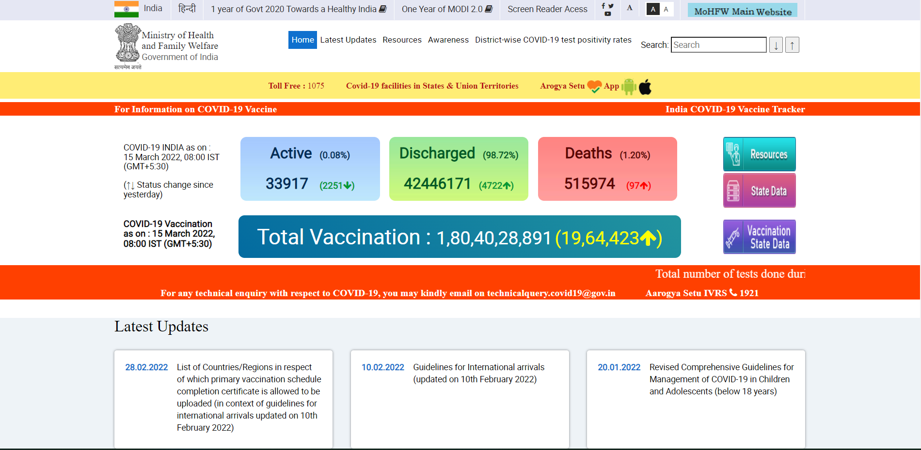
Project Screenshots – Covid 19 Guidelines

Slide 16
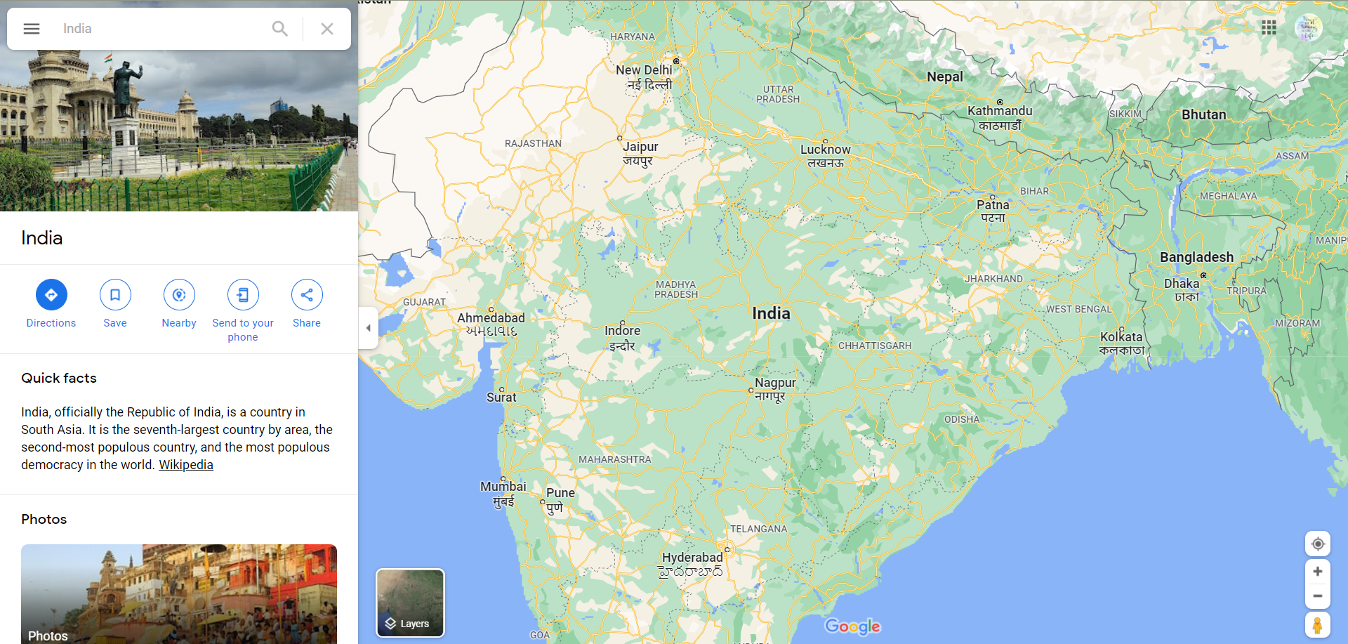
Project Screenshots - Maps

Slide 17
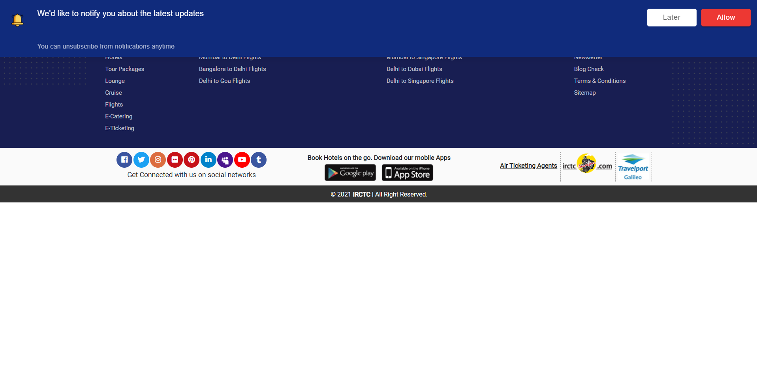
Project Screenshots – By Air

Slide 18
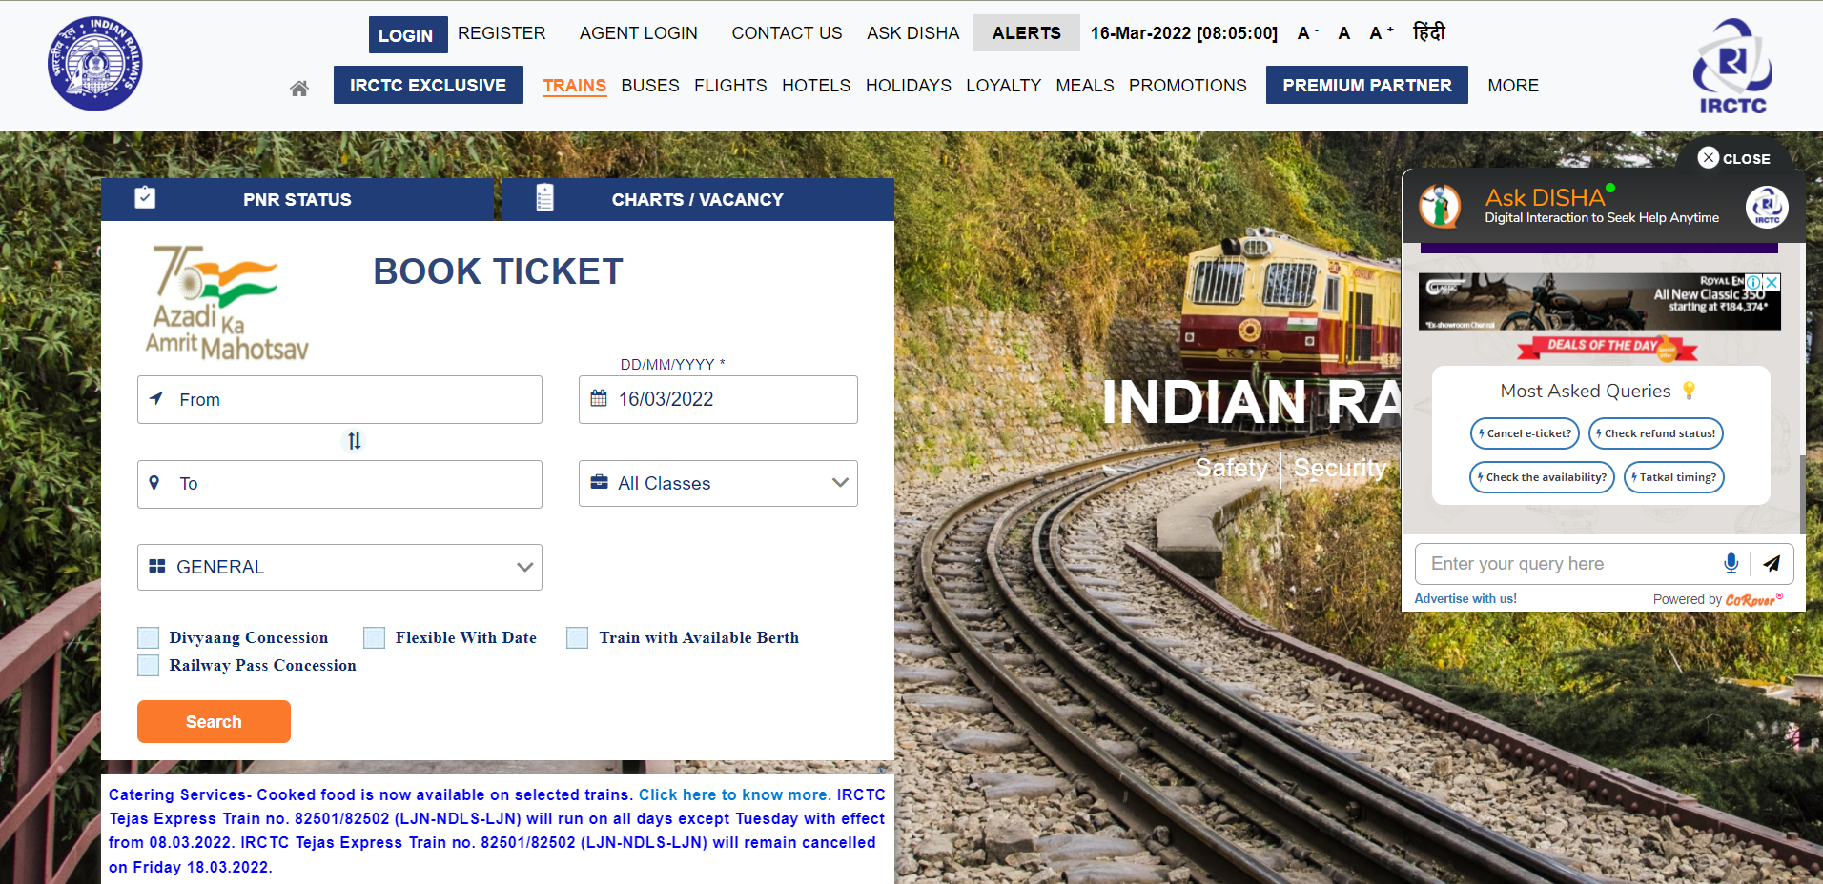
Project Screenshots – By Train

Slide 19
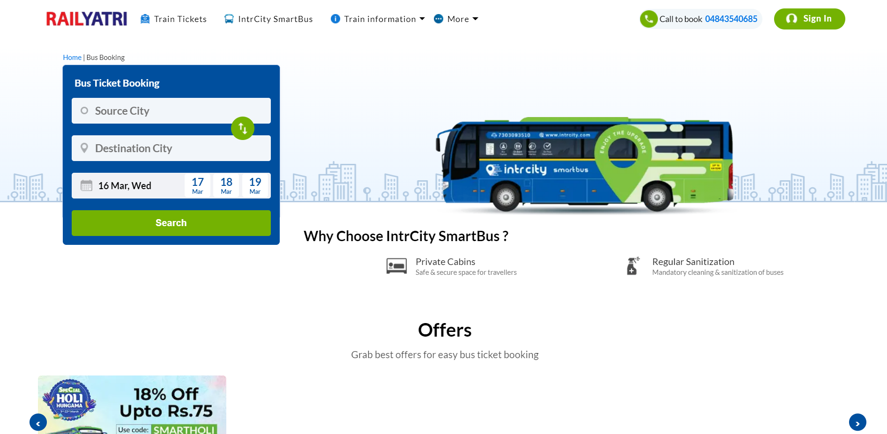
Project Screenshots – By Bus

Slide 20
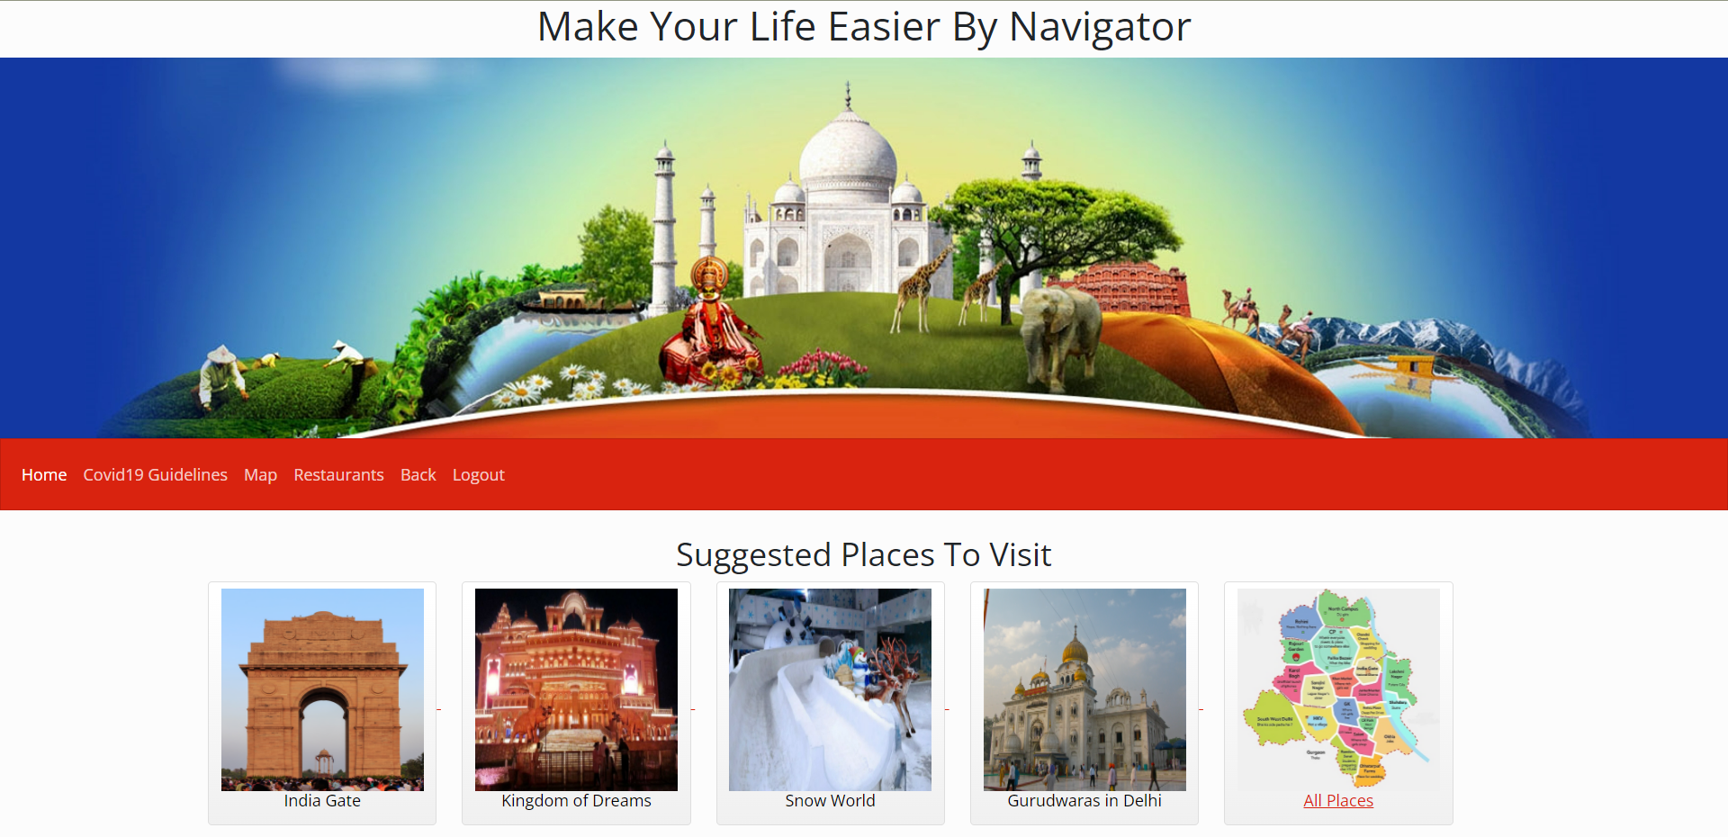
Project Screenshots – Suggested Places in Delhi

Slide 21
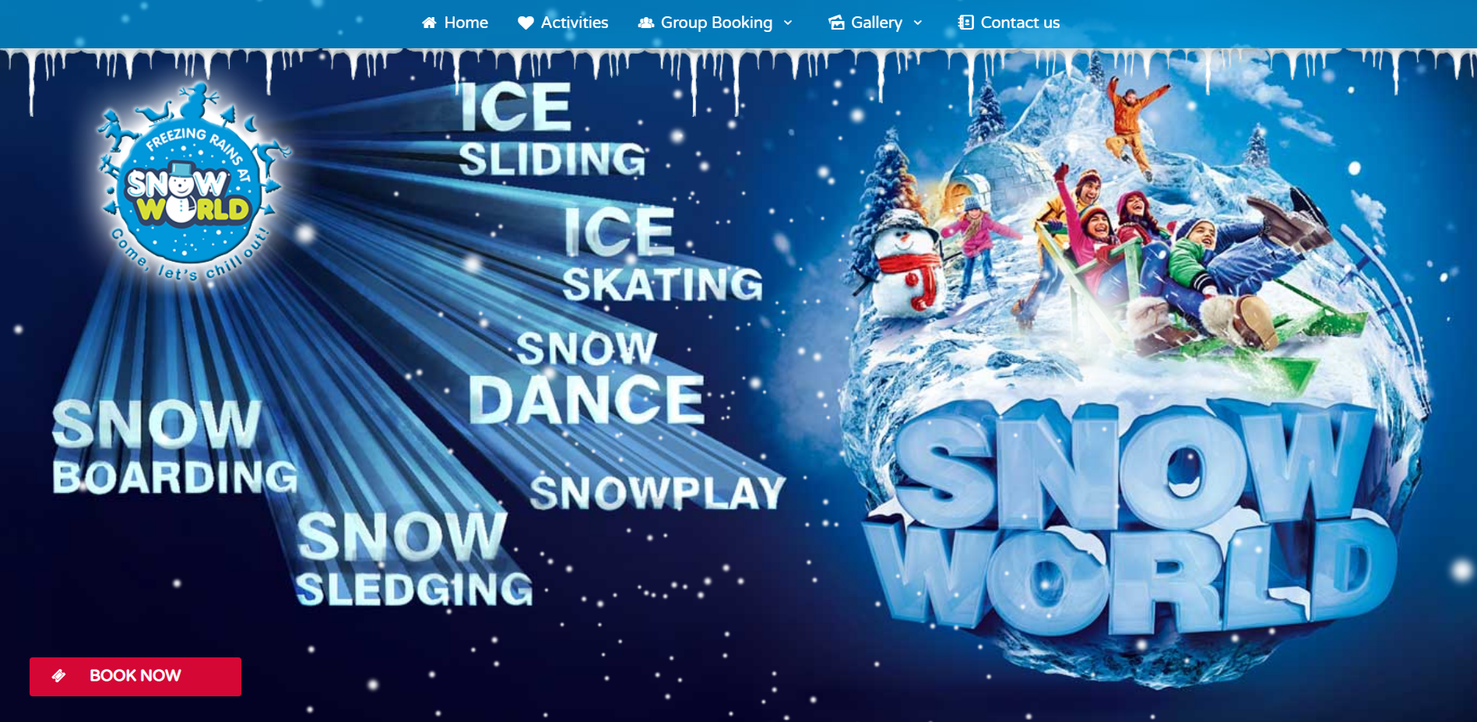
Project Screenshots

Slide 22
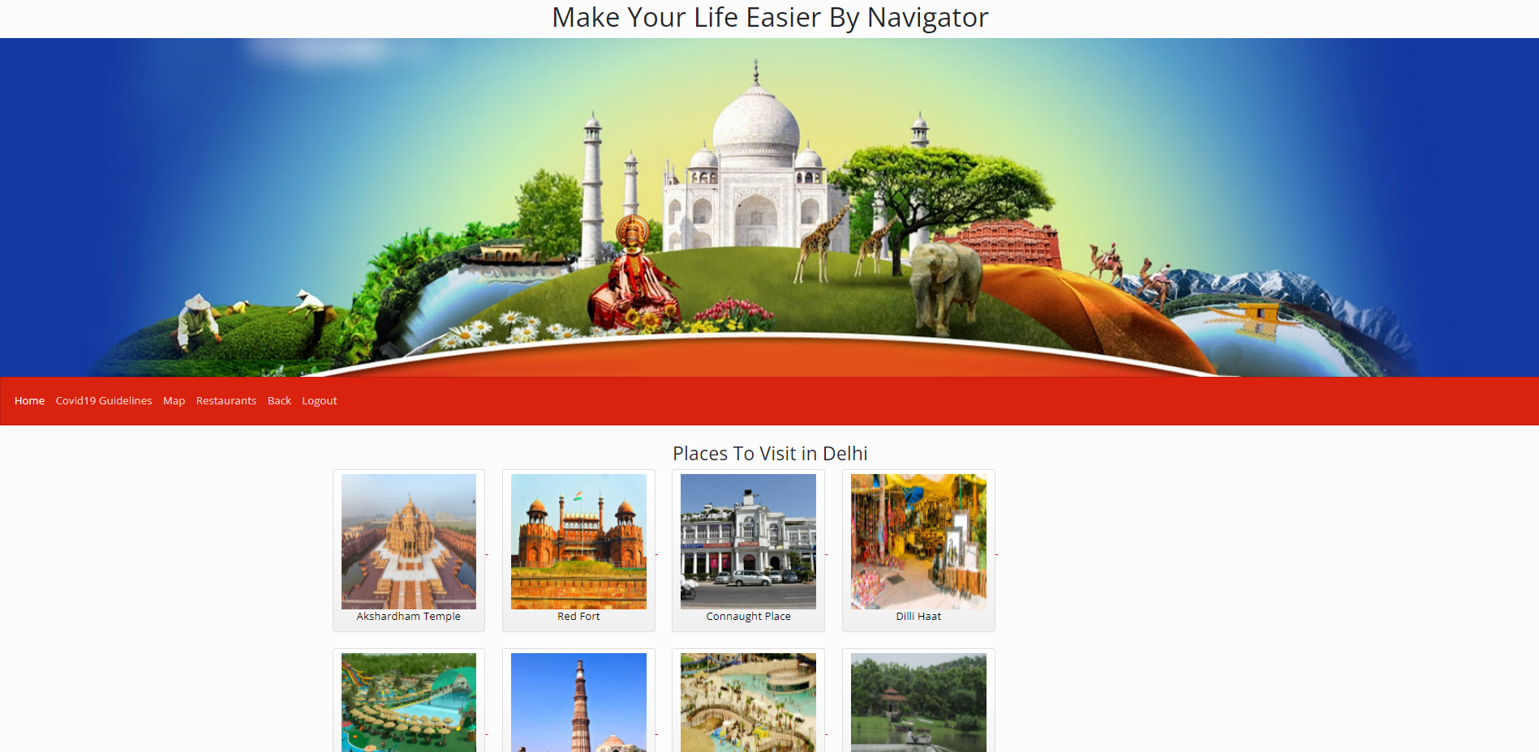
Project Screenshots – All Places

Slide 23
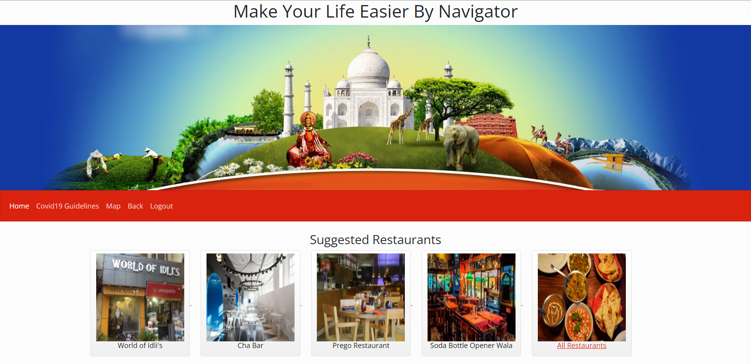
Project Screenshots – Suggested Restaurants

Slide 24
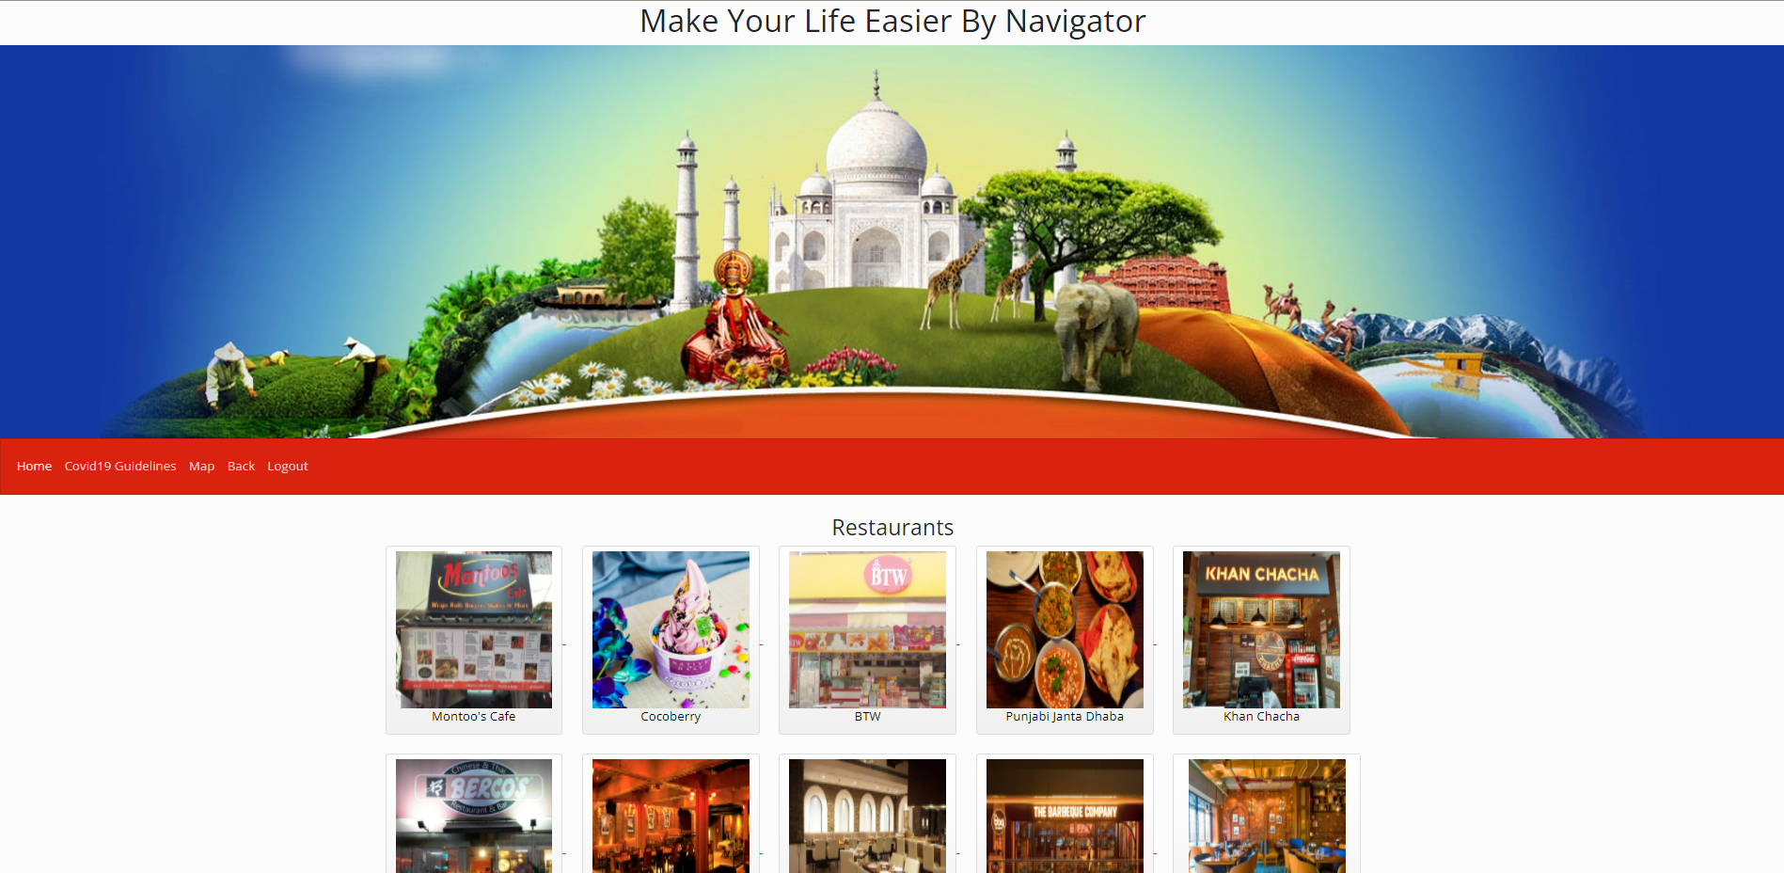
Project Screenshots – All Restaurants

Slide 25


